Slide 1



Trapheus
Rohit Kumar, Namita Devadas
June 11, 2020

Slide 2
Agenda
Problem statement
Solution and Guiding principles
Introduction to Trapheus
Deep dive
Generic solution and motivation for open source

Slide 3

Introduction to Mid-Market
Data volume: 10x more transactions, 5x more customers, 2x more vendors
5-10x more workers.
8x as many apps and 1.6x more jobs to run their business.
Spends 6x the amount of time in the product running their business.
Almost 2X more payroll attach and 1.5x Payment attach.

Slide 4
Problem Statement
Stop the bleeding, build guardrails with well defined performance baselines and SLAs
Improper teardown causes data accumulation over time
Data inconsistency

Slide 5





Solution and Guiding principles
Automated
Cost effective
Scalable
Reusable
Errors, waits and retry handling

Slide 6
Introduction to Trapheus
A tool that enables an automated database restoration pipeline to restore any RDS instance or cluster from a snapshot in AWS.
Modelled as a distributed state machine with the help of AWS step functions
It can be used for individual RDS instances (such as MySQL, Oracle db etc) and for Amazon Aurora cluster based instances.

Slide 7
Deep dive
Trapheus is modelled as a state machine using AWS Step Functions.
The state machine includes the following steps:
Convert the existing instance of the database to a temporary instance.
Restore a new instance of the database using the golden snapshot.
Delete the temporary instance of the database.
As a optional step, there is also a support to update the golden snapshot.

Slide 8
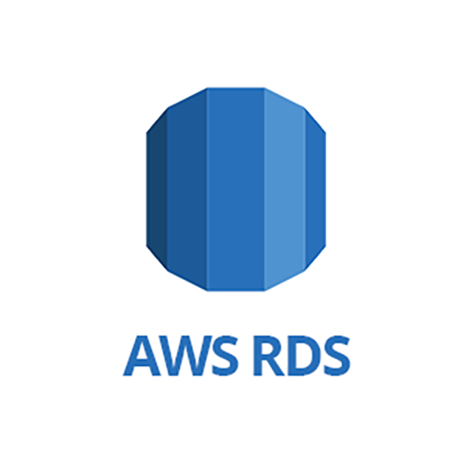
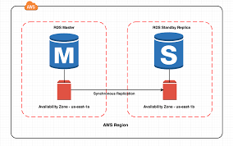
Root State

Slide 9
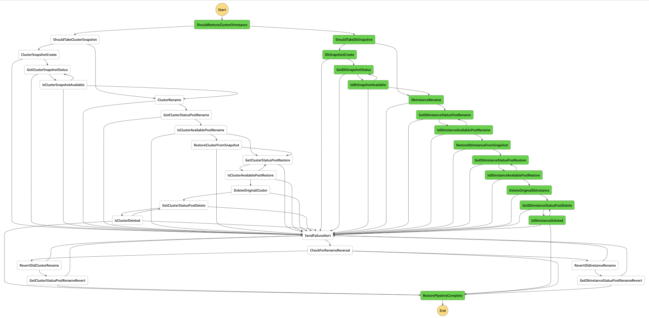

Slide 10
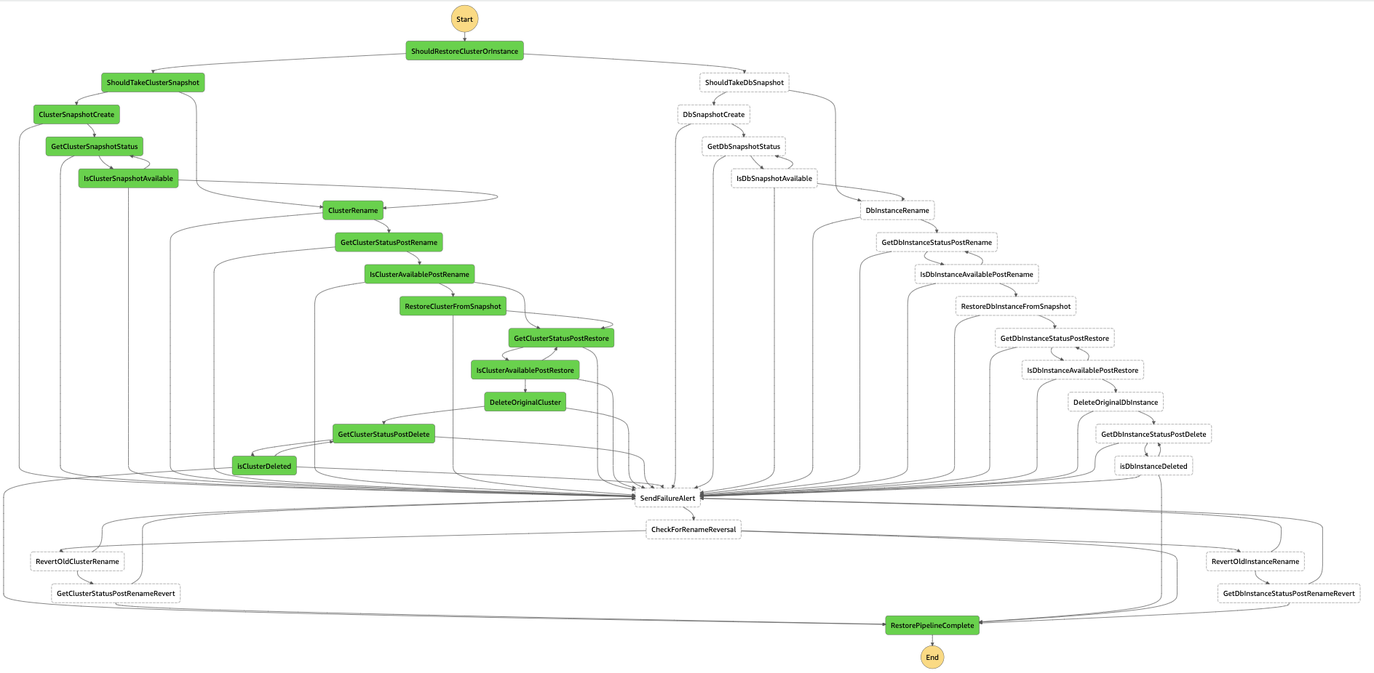

Slide 11
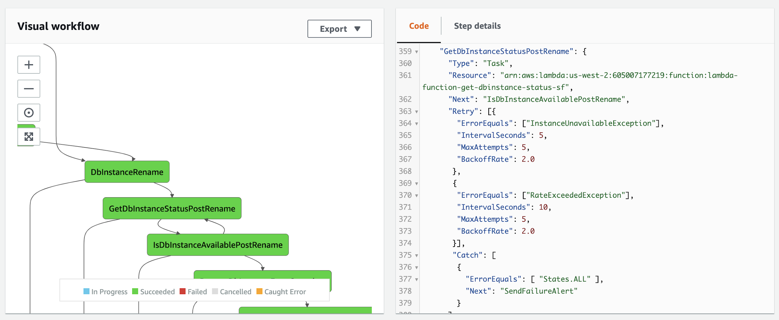
Error and Retry Handling in state machine

Slide 12
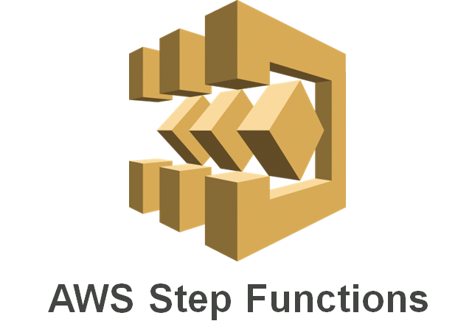

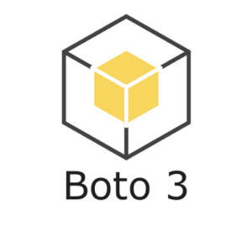

Deep dive continued
Enables multiple AWS services to run as an application. Designing various steps in the workflow as a state machine enables modularisation and makes the workflow easy to understand and debug.
Different steps in the state machine are executed using individual AWS Lambdas for db instances and db clusters respectively.
Python SDK for AWS that executes various operations on AWS RDS. Boto3 custom waiters are used with configurable delays and maximum retry attempts to track status of each operation
Used across all lambdas for abstraction of common utility methods and custom exception handling

Slide 13

Motivation for open source
There is no such concrete tooling available presently which runs this process in a completely automated manner supporting all RDS instances.
When we did this internally it was easily adopted by other QBO teams for their own performance clusters and by microservices such as Batch Orchestration service.
We believe that this solution can be easily be extended for DR activities wherein a DR account can easily restore from the snapshot directly in a target AWS account.

Slide 14
https://github.com/intuit/Trapheus
If you have any questions and would like to discuss further, please reach out to us on slack at @stationeros / @namitad

